Slide 1


Mendelian Randomization CONCEPT & METHODS
Mathilde Boissel mathilde.boissel@univ-lille.fr / mathilde.boissel@cnrs.fr
27/10/2023

Slide 2
Context

Slide 3
Training
The Mendelian Randomization (MR) course is provided by the MRC Biostatistics Unit from Cambridge University (UK). (More detail here http://mendelianrandomization.com/index.php)
In this feedback, we will see
Key words : https://mr-dictionary.mrcieu.ac.uk/
Introduction & motivations of MR
Paradigm & Assumptions
Methods on Individuals level data
Methods on Summary level data and Two Samples MR
Robust Methods, Issues and Sensitivity analyses
Notes:
During 3 weeks in November.
Guidelines in bonus slides

Slide 4
What is Mendelian Randomization
Instrumental variable (IV) analysis using genetic variants to assess causal relationships
Candidate gene study using biological knowledge about function of genetic variants
Target validation for pharmaceutical priorization of modifiable risk factor / pathways
Natural experiment to exploit naturally-occurring variation analogous to a randomized trial
Use of genetic variants as proxies for treatments / interventions to exploit human as the model organism
Investigation of shared heritability of exposure and outcome variable
Short TED Med Live : https://youtu.be/rjMwcTttKoQ
Lecture by George Davey Smith, NTNU trial : https://youtu.be/Whut4Yo-x-A
Notes:
Additional bonus talk - Mechanistic insights on COVID-19 susceptibility from genetic data: https://youtu.be/d6tR49ToQ8I

Slide 5
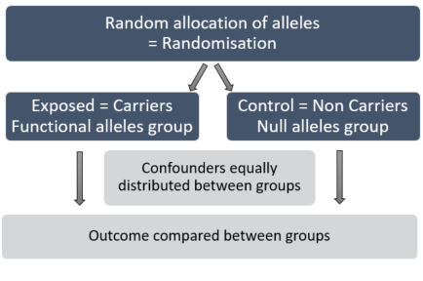
Introduction
Correlation is not causation.
MR is not a simple association test : with its instrumental variable it answers to causality. Use something stable (like genetic) as an instrumental variable to represent a risk factor of interest. Because it’s determined at conception, the genetic sequence can’t be influence by the disease outcome.
Question of MR study : variation in risk factor impact the outcome ?
MR is analogous to a randomized trial : treatment vs placebo, with all confounders equally distributed.
Notes:
Problem with observational data : question of causality uncertain, unmeasured confounding
Question of MR study : What if we change the risk factor? Impact on outcome ?
So why not every one doesn’t just everytime randomized trial ?

Slide 6


Motivation
Financing concern.
Failure in clinical trials.
Genetic help prevent ? X wasn’t a good target, dev drug to modify this pathway won’t change the outcome.
Exploits a natural experiment assuming that genetic variants are quasi-randomized. Genetic variants are proxies for disease treatment (formally instrumental variables)
In MR context, an association between a genetic variant and the outcome implies a causal effect of the risk factor on the outcome.
Notes:
Prevent big expenses

Slide 7
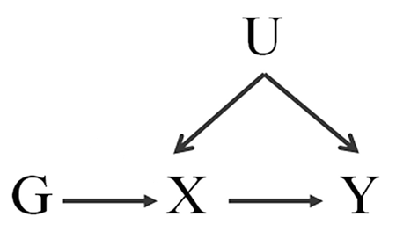
Paradigm
We want to study the causal effect of exposure X on outcome Y using a genetic variant G, in the presence of confounding U.
Notes:
Y is continuous variable or binary outcome (possible but interpretation more complicated)
To do so we must valid some hypothesis …

Slide 8
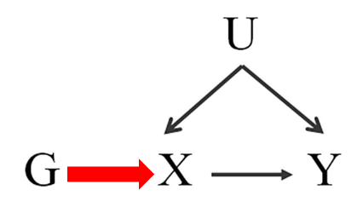
Assumptions
Relevance G is associated with the risk factor (of interest) X Not necessary for G to be a “causal variant” (consequence of LD)
Notes:
Three main assumptions (also called IV Assumptions) i) Not necessary for G to be a “causal variant” (consequence of Linkage Desequilibrium) Only empirically tested: can test association between G and X using linear regression. Not necessary for G to be a “causal variant” (consequence of LD)

Slide 9
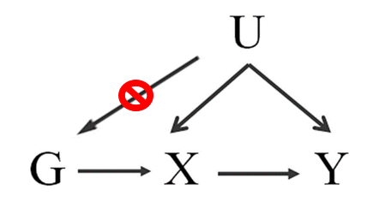
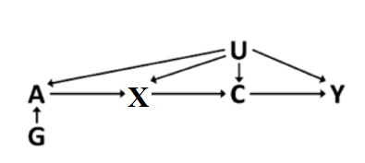
Assumptions
Relevance G is associated with the risk factor (of interest) X Not necessary for G to be a “causal variant” (consequence of LD)
Exchangeability i.e. “No pleiotropy” assumption G is not associated with any potentially confounding variable (U)
Notes:
ii) Pleiotropy refers to a genetic variant being asso with multiple risk factors via different causal mechanisms. Must check that subgroups of pop (genetically-defined) are similar in all ways except for the resulting of their genotype.
(WT) G=O group would have the same distribution of the outcome as the (het) G=1 group.
association test with measured covariates.
Difficulties when not all confounders known or measured. horizontal pleiotropy is ok : G -> A -> B is possible without violating the instrumental variable assumptions

Slide 10
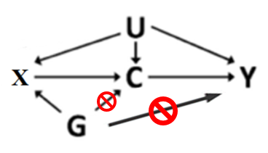
Assumptions
Relevance G is associated with the risk factor (of interest) X Not necessary for G to be a “causal variant” (consequence of LD)
Exchangeability i.e. “No pleiotropy” assumption G is not associated with any potentially confounding variable (U)
Exclusion restriction The only way G can influence (Y) the outcome is via risk factor (X) If you intervene on the genetic variant but keep the risk factor constant, then the outcome will not change, i.e. G and Y are conditionally independent given the risk factor X and U confounders.
Notes:
iii) G and outcome are independent conditional on the risk factor and confounders. i.e.
Can assess by adj the genetic association with the outcome for the risk factor (Y ~ G + X),
if G is a good instrument, the add of X as adj would attenuate the effect $β_{G}$, not a foolproof

Slide 11
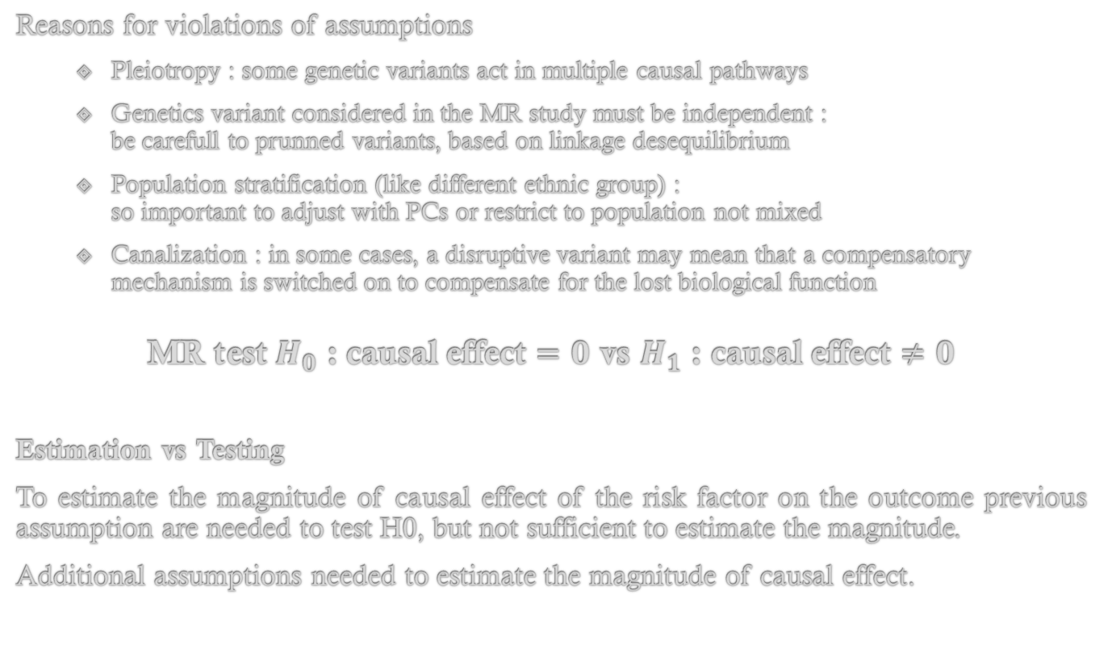
Assumptions
Reasons for violations of assumptions
Pleiotropy : some genetic variants act in multiple causal pathways
Genetics variant considered in the MR study must be independent : be carefull to prunned variants, based on linkage desequilibrium
Population stratification (like different ethnic group) : so important to adjust with PCs or restrict to population not mixed
Canalization : in some cases, a disruptive variant may mean that a compensatory mechanism is switched on to compensate for the lost biological function
MR test $H_{0}$ : causal effect $=0$ vs $H_{1}$ : causal effect $≠0$
Estimation vs Testing
To estimate the magnitude of causal effect of the risk factor on the outcome previous assumption are needed to test H0, but not sufficient to estimate the magnitude.
Additional assumptions needed to estimate the magnitude of causal effect.
11
Notes:
some genetic variants act in multiple causal pathways
be carefull to prunned snps, based on linkage desequilibrium : genetic variants in close proximity are often correlated
Population stratification (sub pop like diff ethnic group, do not have a biological interpretation), so important to adj PCs or restrict pop not mixed
To estimate the magnitude of causal effect of the risk factor on the outcome previous assumption are needed to test H0, but not suffisent to estimate the magnitude. “what is the change in Y for a unit increase on X ?” it the promary goal of the MR investigation.
(provides a sense of the causal relevance of the risk factor in practice, allows combination of evidence across multi G, allows power calculation, allows confidence intervals, allows comparison of causal estimates form diff G)

Slide 12
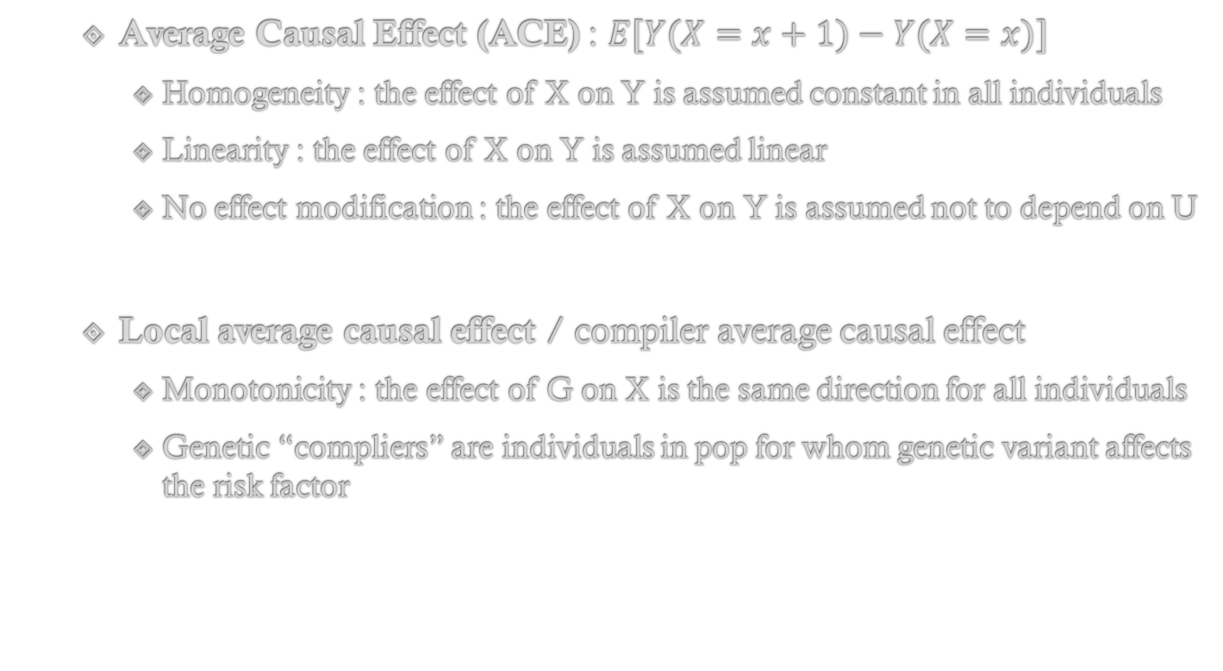
Assumption for Causal Estimation
Average Causal Effect (ACE) : $E[Y(X=x+1)−Y(X=x)]$
Homogeneity : the effect of X on Y is assumed constant in all individuals
Linearity : the effect of X on Y is assumed linear
No effect modification : the effect of X on Y is assumed not to depend on U
Local average causal effect / compiler average causal effect
Monotonicity : the effect of G on X is the same direction for all individuals
Genetic “compliers” are individuals in pop for whom genetic variant affects the risk factor
12
Notes:
Valid the first 3 IV assumptions +
Further assumption necessary for causal estimation
average causal effect (ACE)
« compilers » : are the subgroup of the sample affected by the genetic IV

Slide 13
Bradford-Hill’s Criteria
Plausibility (function of genetic variant (G) acts related to the risk fact / outcome ?)
Consistency (is same direction of causal effect predicted by multiple G ?)
Biological gradient (dose-response relationship to G association with risk fact and outcome ?)
Strength (G explain much variance in the risk factor ?)
Specificity (G association with many risk fact / outcomes ?)
Coherence (causal relation concordant with observational data ?)
Notes:
The big challenge of MR is to build a valid Instrumental Variable G, to do so, Some criteria have been established by …

Slide 14
Methods on Individual Level Data
Notes:
You have a dataset with the risk factor, the outcome, many confonders, and genetic information, so you can run the MR analysis on your own data

Slide 15
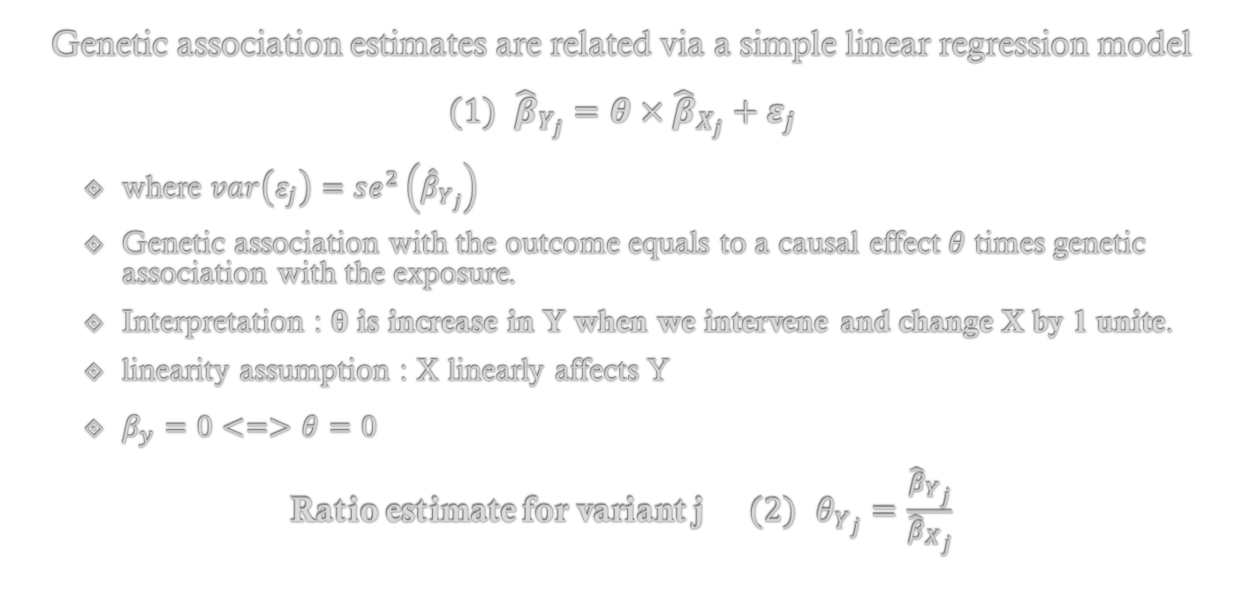
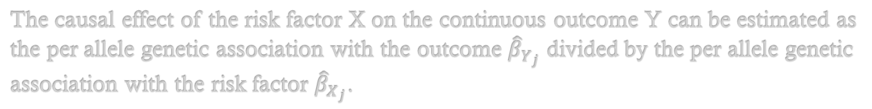
Ratio Method
Genetic association estimates are related via a simple linear regression model $(1) {\hat{β}}_{Y_{j}}=θ×{\hat{β}}_{X_{j}}+ε_{j}$
where $var\left(ε_{j}\right)=se^{2}\left({\hat{β}}_{Y_{j}}\right)$
Genetic association with the outcome equals to a causal effect $θ$ times genetic association with the exposure.
Interpretation : $θ$ is increase in Y when we intervene and change X by 1 unite.
linearity assumption : X linearly affects Y
$β_{y}=0<=>θ=0$
Ratio estimate for variant j $(2) θ_{Y_{j}}=\frac{{\hat{β}}_{Y_{j}}}{{\hat{β}}_{X_{j}}}$
The causal effect of the risk factor X on the continuous outcome Y can be estimated as the per allele genetic association with the outcome ${\hat{β}}_{Y_{j}}$ divided by the per allele genetic association with the risk factor ${\hat{β}}_{X_{j}}$.

Slide 16
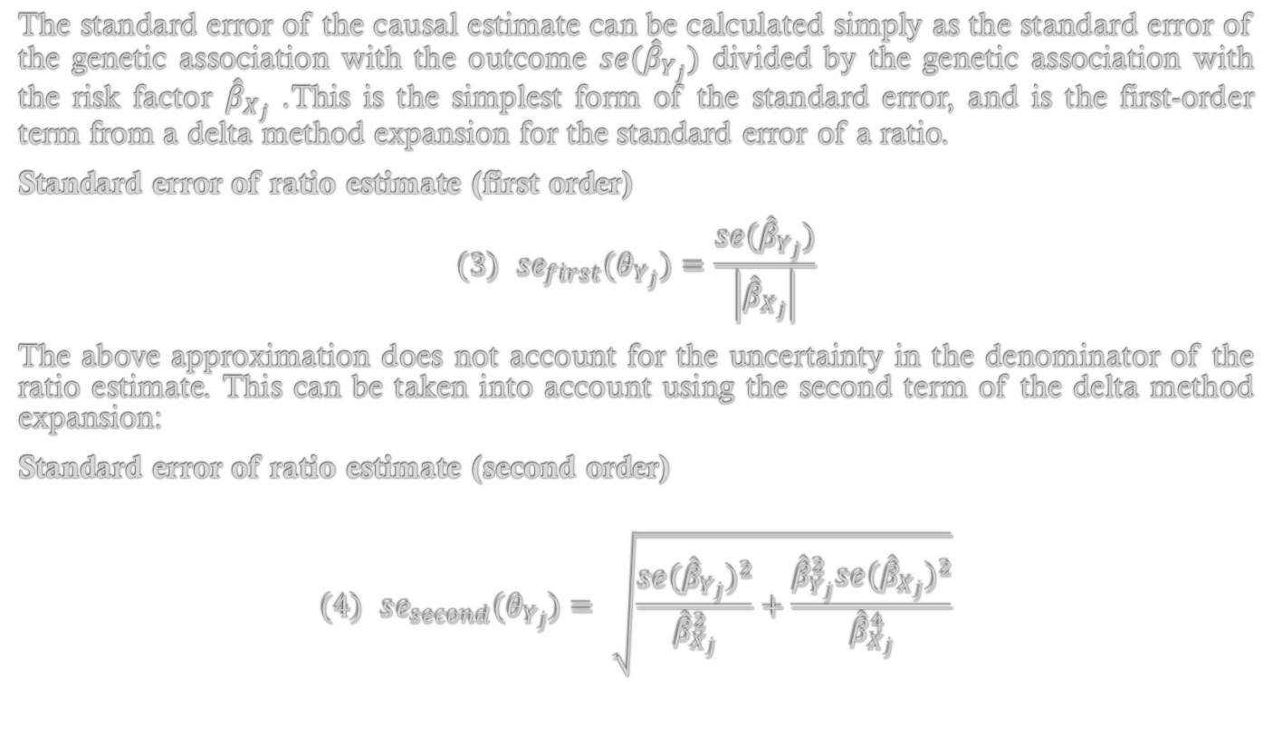
Ratio Method
The standard error of the causal estimate can be calculated simply as the standard error of the genetic association with the outcome $se({\hat{β}}_{Y_{j}})$ divided by the genetic association with the risk factor ${\hat{β}}_{X_{j}}$. This is the simplest form of the standard error, and is the first-order term from a delta method expansion for the standard error of a ratio.
Standard error of ratio estimate (first order)
$$(3) se_{first}(θ_{Y_{j}})=\frac{se({\hat{β}}_{Y_{j}})}{\left|{\hat{β}}_{X_{j}}\right|}$$
The above approximation does not account for the uncertainty in the denominator of the ratio estimate. This can be taken into account using the second term of the delta method expansion:
Standard error of ratio estimate (second order)
$$(4) se_{second}(θ_{Y_{j}})=\sqrt{\frac{se({\hat{β}}_{Y_{j}})^{2}}{{\hat{β}}_{X_{j}}^{2}}+\frac{{\hat{β}}_{Y_{j}}^{2}se({\hat{β}}_{X_{j}})^{2}}{{\hat{β}}_{X_{j}}^{4}}}$$
Notes:
Go fast on those formula,
Just to tell you that you can compute first or second order of standard error
where it's important to take into account uncertainty of beta _ x

Slide 17
Ratio Method
In practice, in R, you can just run
by1 = lm(y~g1)$coef[2] #Genetic asso with the outcome bx1 = lm(x~g1)$coef[2] #Genetic asso with the exposure beta.ratio1 = by1/bx1 beta.ratio1 #Ratio estimate for g1
With Binary Outcome
Gene-outcome association : Use logistic regression glm(y.bin~g1, family=binomial)
Gene-risk association : Use linear regression in controls only lm(x[y.bin==0]~g1[y.bin==0])
In a case control setting, it is usual to regress the risk factor on the genetic variant in controls only because the case-control sample is generally unrepresentative of the population and if measurements of the risk factor are made post-disease = Avoid possible reverse causation.
Notes:
Evaluate the ratio estimate and its standard error for G
Will compute the numerator using logistic regression to calculate the numerator (gene-outcome association, glm(y.bin~g1, family=binomial))
And the denominator with linear regression in controls only to calculate the denominator (lm(x[y.bin==0]~g1[y.bin==0])).
In a case control setting, it is usual to regress the risk factor on the genetic variant in controls only because the case-control sample is generally unrepresentative of the population and if measurements of the risk factor are made post-disease => possible reverse causation.

Slide 18
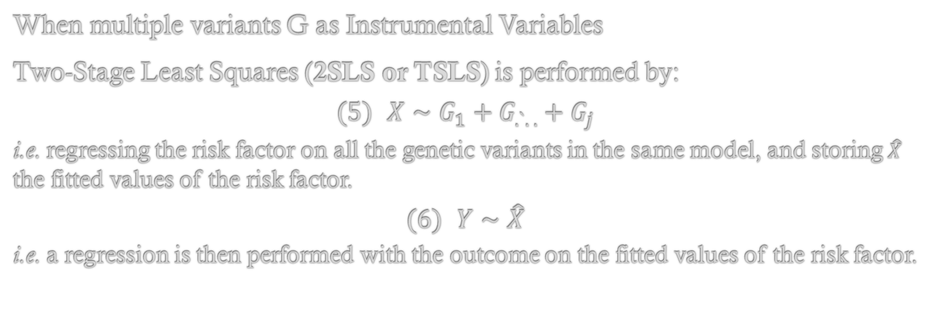
Two-Stage Least Squares Method
When multiple variants G as Instrumental Variables
Two-Stage Least Squares (2SLS or TSLS) is performed by:
$$(5) X∼G_{1}+G_{.`. .}+G_{j}$$ i.e. regressing the risk factor on all the genetic variants in the same model, and storing $\hat{X}$ the fitted values of the risk factor.
$$(6) Y∼\hat{X}$$ i.e. a regression is then performed with the outcome on the fitted values of the risk factor.
With a single instrumental genetic variation, 2SLS and Ratio method are identical.
With multi genetic variants as IV, the 2SLS estimate is a weighted average of the ratio estimates.
2SLS need to adjust the standard error (by hand must adj calculation, or adj ever implemented in MR R-packages)

Slide 19
Two-Stage Least Squares Method
In practice, in R, you may want to run step 1 fitted.values=lm(x~g1+g2+g3+g4)$fitted step 2 lm(y~fitted.values)
In real practice,
Performing two-stage least squares by hand is generally discouraged, as the standard error in the second-stage of the regression does not take into account uncertainty in the first-stage regression.
The R package performs the two-stage least squares method using the ivreg function: ivreg(y~x|g1+g2+g3+g4, x=TRUE)
(from the R package AER, loaded with ivpack)
With Binary Outcome
First stage with a binary outcome is only conducted on controls Second step is done with a logistic regression
Notes:
With binary (ever said)
In practice, first stage with a binary outcome is only conducted on controls, the second step is done with a logistic regression
The causal effect of the risk factor x on the binary outcome y.bin can also be estimated as the per allele genetic association with the outcome divided by the per allele genetic association with the risk factor.
However, with a binary outcome, logistic regression should be used for regression of the outcome on the genetic variant, particularly in a case-control setting.
Also, in a case control setting, it is usual to regress the risk factor on the genetic variant in controls only. The glm function with an extra argument of family = binomial can be used to perform logistic regression in the same way that lm is used to perform linear regression.

Slide 20
F-Statistic
The F-statistic from the regression of the risk factor on the genetic variant(s) is used as a measure of ‘weak instrument bias’, with smaller values suggesting that the estimate may suffer from weak instrument bias.
Care should be taken when interpreting the F-statistic from observed data. Some studies recommend excluding genetic variants if they have a F-statistic less than 10. Using such a stringent cut-off may introduce more bias than it prevents, as the estimated F-statistic can show considerable variation and may not provide a good indication of the true strength of the instrument.
Notes:
To finish with this part,
After having ran your regressions, you will ask to your self, does my genetic instrument works well .. Is it strong ? The F statistic may help to answer

Slide 21
Methods on Summary Level Data
Notes:
You have no dataset in your lab, but you know that many studies have ever get estimates about the risk factor and outcome you are interested in.

Slide 22
Summary Level Data
Many consortia release GWAS summary - GWAS Catalog The NHGRI-EBI Catalog of human genome-wide association studies - Uk Bio Bank 361,194 subjects, 4,203 phenotypes, covariates adjustement as 2 pcs, sex and age (http://www.nealelab.is/uk-biobank), and pan-ancestry genetic analysis of the UK BioBank (https://pan.ukbb.broadinstitute.org) - FinnGen consortium 96,499 samples, 16,152,119 variants and 1,122 endpoints phenotypes available - PhenoScanner A database of human genotype-phenotype associations, Available in library(MendelianRandomization) with function pheno_input()
Notes:
.. But some time one single database do not contain all what you need…

Slide 23
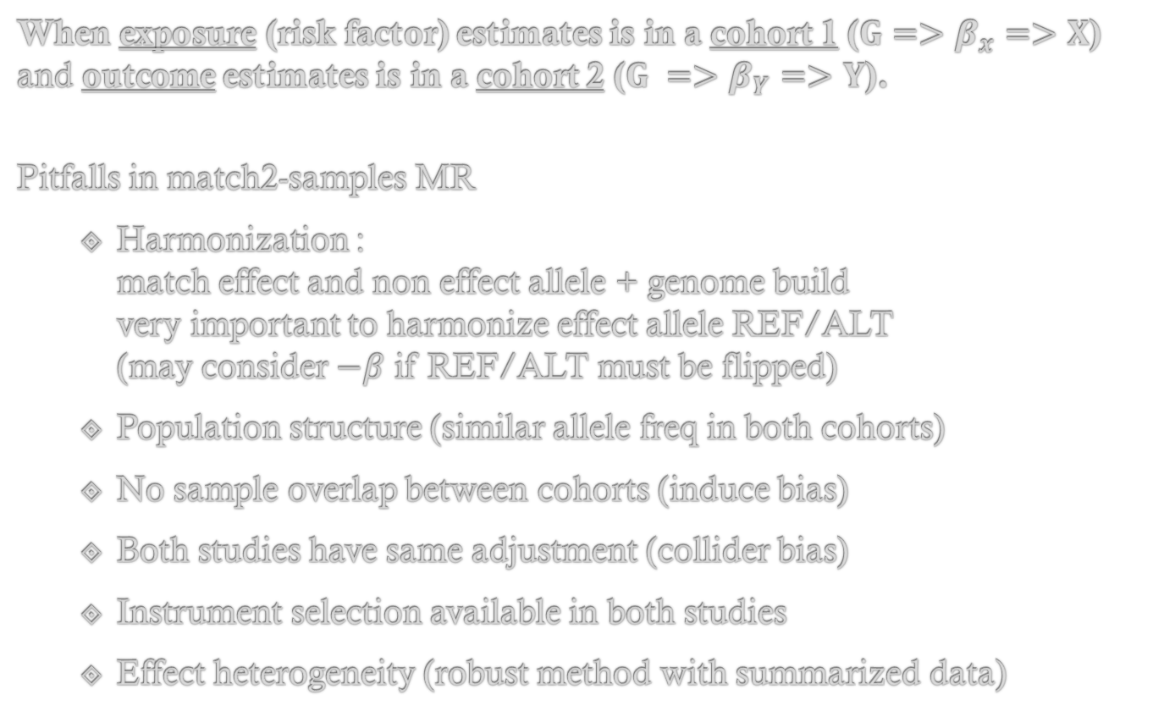
Two Samples (2-Samples) MR
When exposure (risk factor) estimates is in a cohort 1 ($G=>β_{x}=>X$) and outcome estimates is in a cohort 2 ($G =>β_{Y}=>Y$).
Pitfalls in match2-samples MR
Harmonization : match effect and non effect allele + genome build very important to harmonize effect allele REF/ALT (may consider $−β$ if REF/ALT must be flipped)
Population structure (similar allele freq in both cohorts)
No sample overlap between cohorts (induce bias)
Both studies have same adjustment (collider bias)
Instrument selection available in both studies
Effect heterogeneity (robust method with summarized data)
Notes:
.. But some time one single database do not contain all what you need…
So you will run a 2 samples MR.
It’s just a case, not a special method.
Def : For a j SNPs, we need the genetic associations $B_{X_{j}}$ (asso with X and variant j) in cohort 1 and $B_{Y_{j}}$ (asso with Y and variant j) in cohort 2

Slide 24
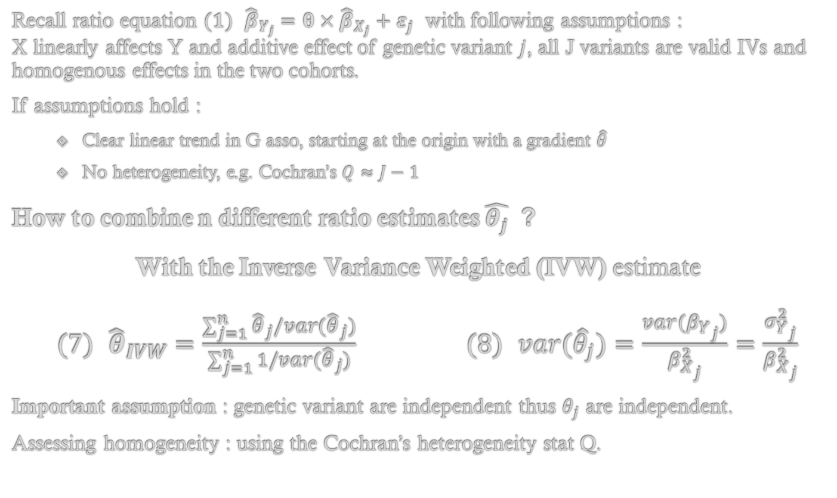
Inverse Variance Weighted Method
Recall ratio equation $(1) {\hat{β}}_{Y_{j}}=θ×{\hat{β}}_{X_{j}}+ε_{j}$ with following assumptions : X linearly affects Y and additive effect of genetic variant $j$, all J variants are valid IVs and homogenous effects in the two cohorts.
If assumptions hold :
Clear linear trend in G asso, starting at the origin with a gradient $\hat{θ}$
No heterogeneity, e.g. Cochran’s $Q≈J−1$
How to combine n different ratio estimates $\hat{θ_{j}}$ ?
With the Inverse Variance Weighted (IVW) estimate
$(7) {\hat{θ}}_{IVW}=\frac{\sum_{j=1}^{n}{{\hat{θ}}_{j}}/var({\hat{θ}}_{j})}{\sum_{j=1}^{n}{1}/var({\hat{θ}}_{j})}$ $(8) var({\hat{θ}}_{j})=\frac{var(β_{Y_{j}})}{β_{X_{j}}^{2}}=\frac{σ_{Y_{j}}^{2}}{β_{X_{j}}^{2}}$
Important assumption : genetic variant are independent thus $θ_{j}$ are independent.
Assessing homogeneity : using the Cochran’s heterogeneity stat Q.
24
Notes:
All J variants are valid IVs, $𝔼[{\hat{β}}_{Y_{j}}/{\hat{β}}_{X_{j}}]=0,j=1,2,...,J$
How to account for heterogeneity ? Multiplicative random effects (MRE) model, Additive random effects (ARE) model or adj in the regression.
How to account for heterogeneity ? More robust method …
Multiplicative random effects (MRE) model where we scale the variance with the Q stat. Note that variance is inflated.
Automatic adj in the regression.
Additive random effects (ARE) model where we change the point estimate with $τ^{2}$, estimated by the “DerSimonian and Laird” or an Empirical Bayes approach.

Slide 25
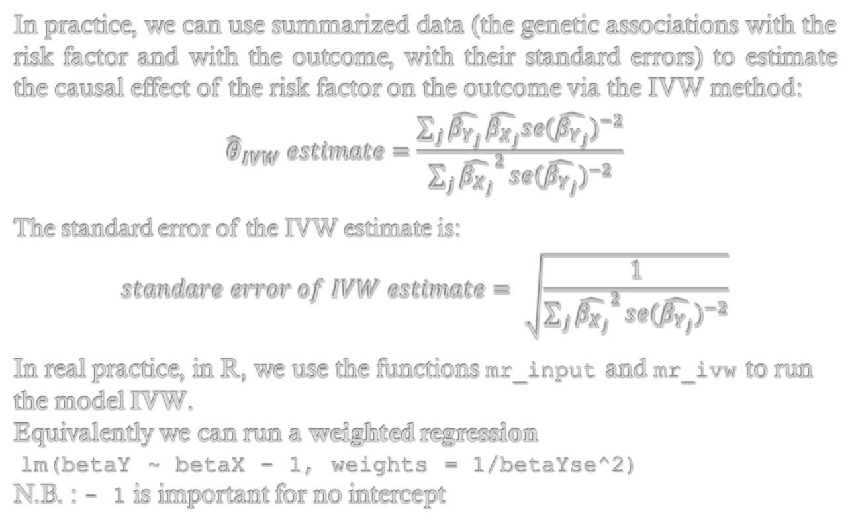
Inverse Variance Weighted Method
In practice, we can use summarized data (the genetic associations with the risk factor and with the outcome, with their standard errors) to estimate the causal effect of the risk factor on the outcome via the IVW method:
$${\hat{θ}}_{IVW} estimate=\frac{\sum_{j}^{​}{\hat{β_{Y_{j}}}}\hat{β_{X_{j}}}se(\hat{β_{Y_{j}}})^{−2}}{\sum_{j}^{​}{{\hat{β_{X_{j}}}}^{2}}se(\hat{β_{Y_{j}}})^{−2}}$$ The standard error of the IVW estimate is:
$$standare error of IVW estimate=\sqrt{\frac{1}{\sum_{j}^{​}{{\hat{β_{X_{j}}}}^{2}}se(\hat{β_{Y_{j}}})^{−2}}}$$
In real practice, in R, we use the functions mr_input and mr_ivw to run the model IVW. Equivalently we can run a weighted regression lm(betaY ~ betaX - 1, weights = 1/betaYse^2) N.B. : - 1 is important for no intercept

Slide 26
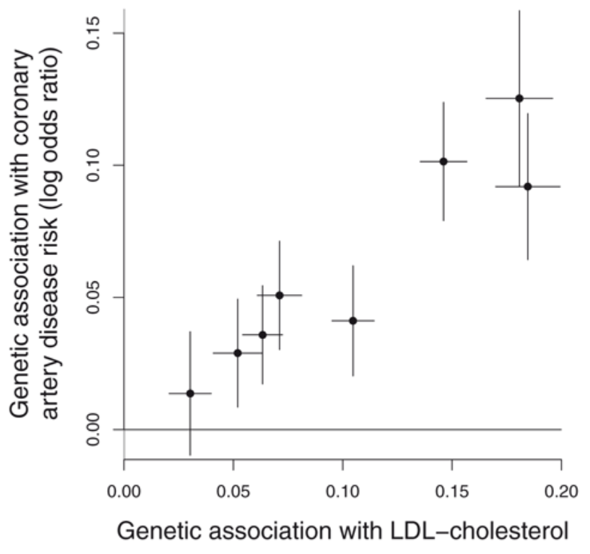
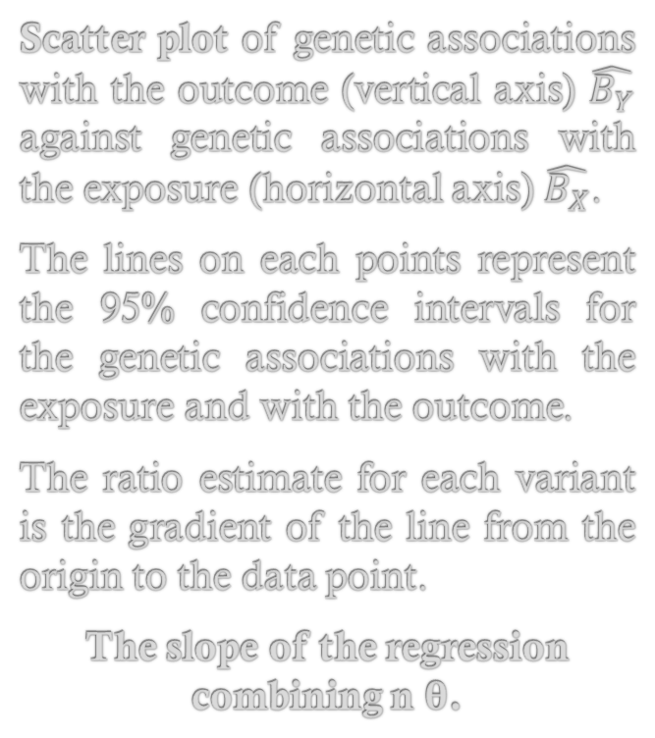
Graphics
Scatter plot of genetic associations with the outcome (vertical axis) $\hat{B_{Y}}$ against genetic associations with the exposure (horizontal axis) $\hat{B_{X}}$.
The lines on each points represent the 95% confidence intervals for the genetic associations with the exposure and with the outcome.
The ratio estimate for each variant is the gradient of the line from the origin to the data point.
The slope of the regression combining n $θ$.
Guidelines for performing Mendelian randomization investigations, Stephen Burgess et al.
Notes:
Figure 5. Scatter plot of genetic associations with the outcome (vertical axis) against genetic associations with the exposure (horizontal axis).
See : Guidelines for performing Mendelian randomization investigations: update for summer 2023 , Stephen Burgess et al
https://www.ncbi.nlm.nih.gov/pmc/articles/PMC7384151/ https://wellcomeopenresearch.org/articles/4-186

Slide 27
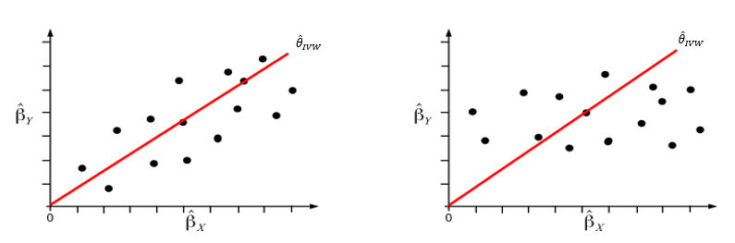
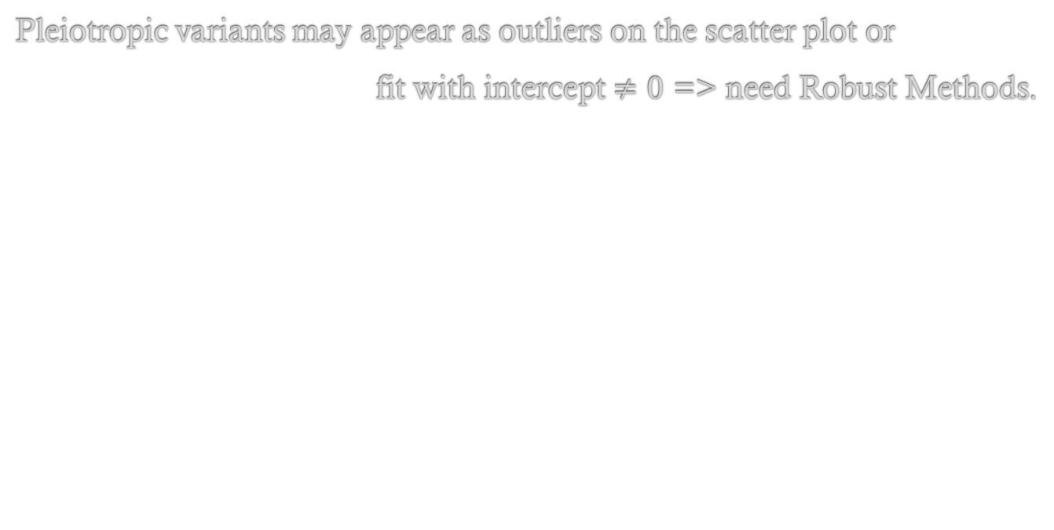
Graphics
Pleiotropic variants may appear as outliers on the scatter plot or
fit with intercept $≠0$ => need Robust Methods.
Balanced vs directional pleiotropy, by Apostolos Gkatzionis
Notes:
left : increased heterogeneity but zero intercept linear trend appears correct => IVW is appropriate but random-effect model needed right : Pleiotropy causing heterogeneity, appears to violate the zero intercept assumption => IVW inappropriate

Slide 28
Robust Methods

Slide 29
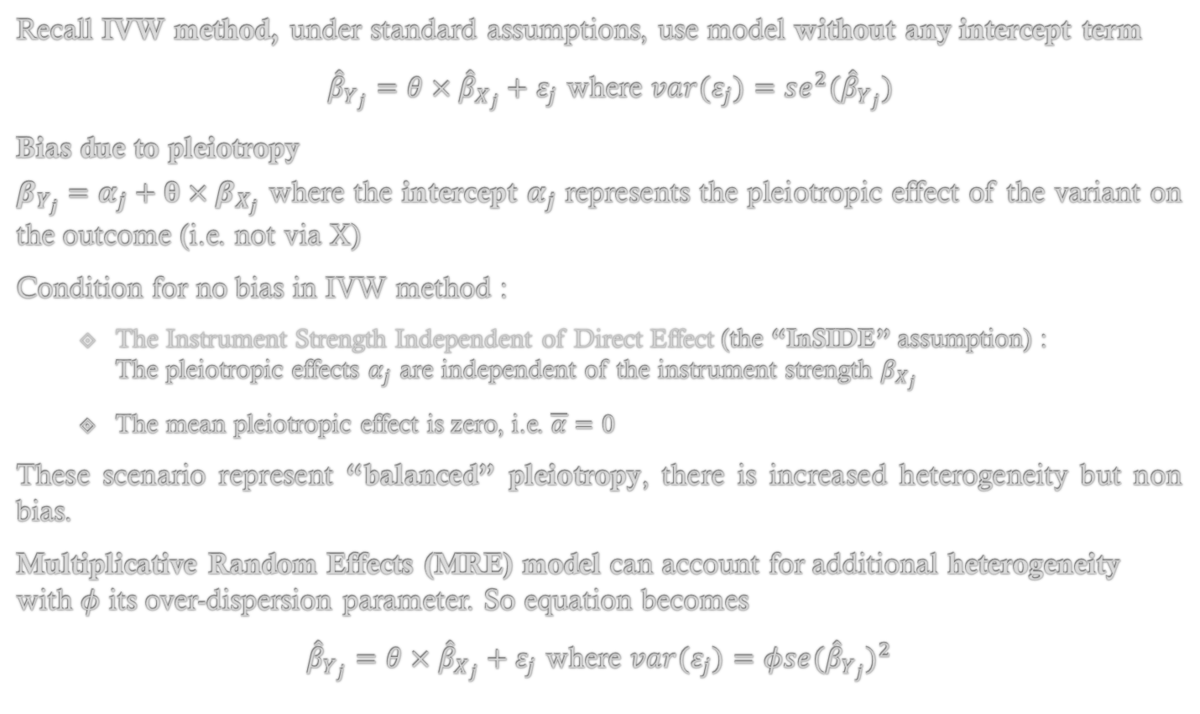
IVW and MRE Model
Recall IVW method, under standard assumptions, use model without any intercept term
${\hat{β}}_{Y_{j}}=θ×{\hat{β}}_{X_{j}}+ε_{j}$ where $var(ε_{j})=se^{2}({\hat{β}}_{Y_{j}})$
Bias due to pleiotropy
$β_{Y_{j}}=α_{j}+θ×β_{X_{j}}$ where the intercept $α_{j}$ represents the pleiotropic effect of the variant on the outcome (i.e. not via X)
Condition for no bias in IVW method :
The Instrument Strength Independent of Direct Effect (the “InSIDE” assumption) : The pleiotropic effects $α_{j}$ are independent of the instrument strength $β_{X_{j}}$
The mean pleiotropic effect is zero, i.e. $\overline{α}=0$
These scenario represent “balanced” pleiotropy, there is increased heterogeneity but non bias.
Multiplicative Random Effects (MRE) model can account for additional heterogeneity with $φ$ its over-dispersion parameter. So equation becomes
${\hat{β}}_{Y_{j}}=θ×{\hat{β}}_{X_{j}}+ε_{j}$ where $var(ε_{j})=φse({\hat{β}}_{Y_{j}})^{2}$
Notes:
With IVW to be more robust must control mean pleiotropy…
The Instrument Strength Independent of Direct Effect (InSIDE) assumption : The assumption states that the association between the genetic instrument and exposure is not correlated with path from the genetic instrument to the outcome that is independent of the exposure of interest.
Multiplicative random effects (MRE) model where we scale the variance with the Q stat. Note that variance is inflated.

Slide 30
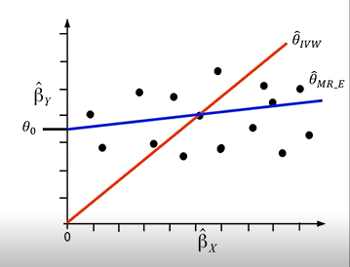
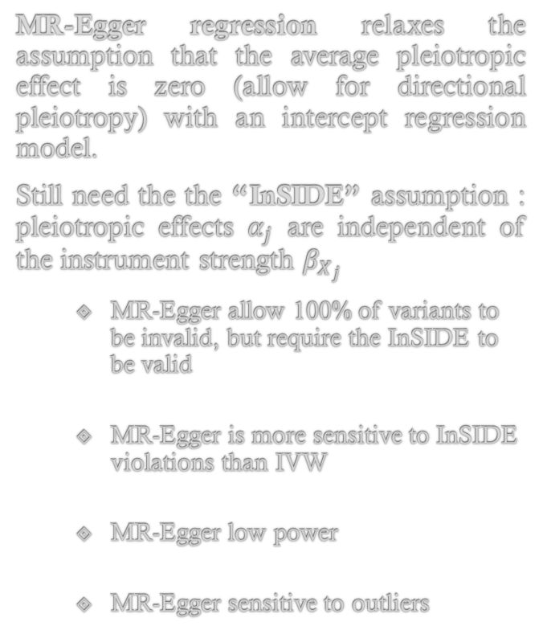
MR-Egger
MR-Egger regression relaxes the assumption that the average pleiotropic effect is zero (allow for directional pleiotropy) with an intercept regression model.
Still need the the “InSIDE” assumption : pleiotropic effects $α_{j}$ are independent of the instrument strength $β_{X_{j}}$
MR-Egger allow 100% of variants to be invalid, but require the InSIDE to be valid
MR-Egger is more sensitive to InSIDE violations than IVW
MR-Egger low power
MR-Egger sensitive to outliers
Robust methods with summarized data session by Apostolos Gkatzionis
Notes:
(Attention, The InSIDE assumption is often violated, particulary if pleiotropy effect act via a confounder)

Slide 31
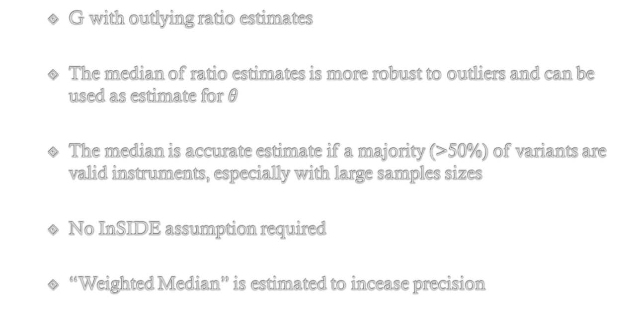
Median Based Estimation
G with outlying ratio estimates
The median of ratio estimates is more robust to outliers and can be used as estimate for $θ$
The median is accurate estimate if a majority (>50%) of variants are valid instruments, especially with large samples sizes
No InSIDE assumption required
“Weighted Median” is estimated to incease precision
Notes:
outlying = ratio estimations aberrantes

Slide 32
Mode Based Estimation
Like median more robust than IVW if outliers
So take ratio estimates, fit a smooth curve (kernel) to model their distribution and use the mode of that distribution as the overall causal effect estimate
Required a plurality of genetic variants to be valid (not >50%)
Simple and weighted version, like median
Can be sensitive to weak instruments.

Slide 33
Recent Robust Methods
MR-Presso (Verbanck et al. 2018) Outlier detection and deletion method, performs an overall heterogeneity test and test of validity for each variant. Works well when there are few strongly pleiotropic variants, not so well with many moderately pleiotropic variants MR-Robust (Rees et al. 2019) Fits weighted linear regression like IVW but adds a loss function to reduce the influence of outlying variants Contamination Mixture (Burgess et al 2019) Fits a mixture model to ratio estimates. Relied on a plurality assumption, similar to the mode Can yield disjoint confidence intervals, has low MSE but may have inflated Type I errors MR-Mix (Qi & Chatterjee 2019) Also a mixture-model approach Requires summary statistics for variants not associated with X Good uncertainty quantification (nominal Type I error rates) but occasionally lacks power MR-Ras (Zhao et al 2018) Models pleiotropic term as normally distributed random effects, estimates using profile regression Guarantees of asymptotic performance, adj for weak instrument bias MR-clust (Foley et al 2020) Clusters genetic variants into groups with similar ratio estimates Tries to identify variants with similar biological function
More detail about comparison : Review paper by Slob & Burgess (2020)

Slide 34
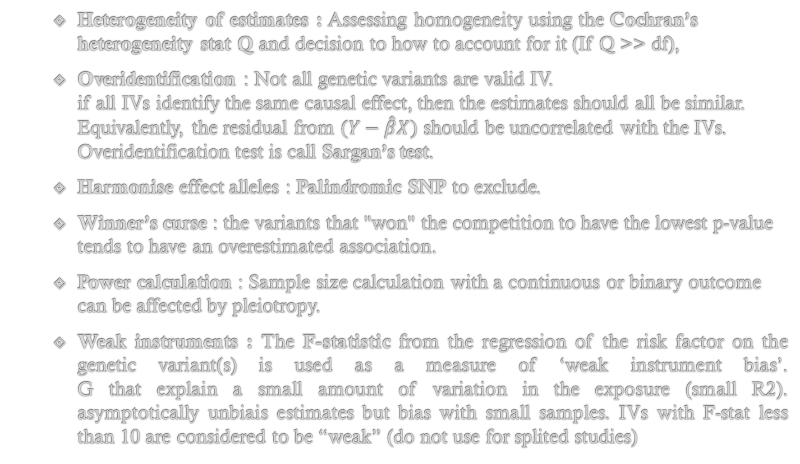
Issues in MR
Heterogeneity of estimates : Assessing homogeneity using the Cochran’s heterogeneity stat Q and decision to how to account for it (If Q >> df),
Overidentification : Not all genetic variants are valid IV. if all IVs identify the same causal effect, then the estimates should all be similar. Equivalently, the residual from $(Y−\hat{β}X)$ should be uncorrelated with the IVs. Overidentification test is call Sargan’s test.
Harmonise effect alleles : Palindromic SNP to exclude.
Winner’s curse : the variants that "won" the competition to have the lowest p-value tends to have an overestimated association.
Power calculation : Sample size calculation with a continuous or binary outcome can be affected by pleiotropy.
Weak instruments : The F-statistic from the regression of the risk factor on the genetic variant(s) is used as a measure of ‘weak instrument bias’. G that explain a small amount of variation in the exposure (small R2). asymptotically unbiais estimates but bias with small samples. IVs with F-stat less than 10 are considered to be “weak” (do not use for splited studies)
Notes:
Heterogeneity of estimates Assessing homogeneity using the Cochran’s heterogeneity stat Q. and decision to How to account for heterogeneity If different genetic variants affect different causal pathways, may identify diff causal effects.
If Q much larger than its degrees of freedom (No. of IVs minus 1), this provides evidence for heterogeneity and invalid instruments.
Winner’s curse (fr malédiction du vainqueur) : same dataset is used for identidying genetic variant to use as instruments and also used for know the genetic association with the exposure. risk bias related where the associassion instrument is over estimated Detail Winner’s curse : so let’s say that in reality we have 10 genetic variants, and the true beta-coefficient for each variant with infinite data is +0.2. suppose that we estimate the genetic associations of each of the 10 variants. sometimes we will get slightly more than +0.2, sometimes slightly less. if we only select the variant with the largest estimated beta, then that estimate will tend to be an overestimate. or if we only consider variants with p<5x10-8 or whatever fixed threshold. again, the more significant the estimate, the more likely there is to be bias. the variant that “won” the competition to have the lowest p-value tends to have an overestimated association.
F stat : (observation : weak if IV corr with confounders. Pb with F-stat < 10 rule : split study => F stat vary)
summary(lm(x~g1))$f[1]
summary(lm(x~g1+g2+g3+g4))$f[1]

Slide 35
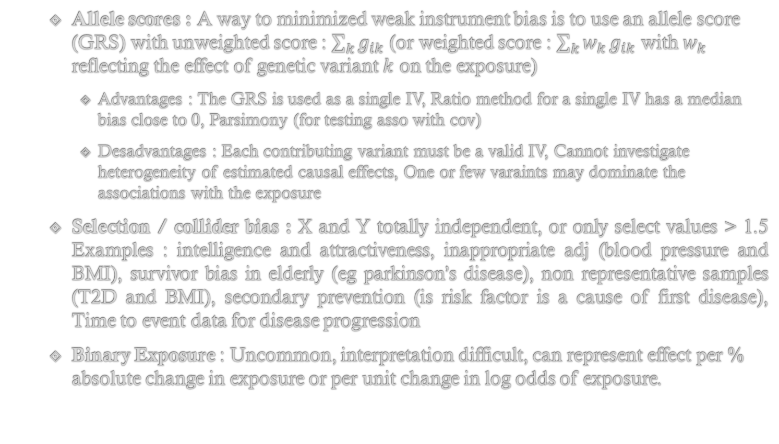
Issues in MR
Allele scores : A way to minimized weak instrument bias is to use an allele score (GRS) with unweighted score : $\sum_{k}^{​}{g_{ik}}$ (or weighted score : $\sum_{k}^{​}{w_{k}}g_{ik}$ with $w_{k}$ reflecting the effect of genetic variant $k$ on the exposure)
Advantages : The GRS is used as a single IV, Ratio method for a single IV has a median bias close to 0, Parsimony (for testing asso with cov)
Desadvantages : Each contributing variant must be a valid IV, Cannot investigate heterogeneity of estimated causal effects, One or few varaints may dominate the associations with the exposure
Selection / collider bias : X and Y totally independent, or only select values > 1.5 Examples : intelligence and attractiveness, inappropriate adj (blood pressure and BMI), survivor bias in elderly (eg parkinson’s disease), non representative samples (T2D and BMI), secondary prevention (is risk factor is a cause of first disease), Time to event data for disease progression
Binary Exposure : Uncommon, interpretation difficult, can represent effect per % absolute change in exposure or per unit change in log odds of exposure.
Notes:
Colocalization : refers to when the same causal variants influence two traits Is a single snp affecting trait 1 and 2 ? like to ask is the genetic architecture same for trait 1 and trait 2 (in a CRISPER-cas9 experiment). like pleiotropy test but in a region of interest (because of LD structure).

Slide 36
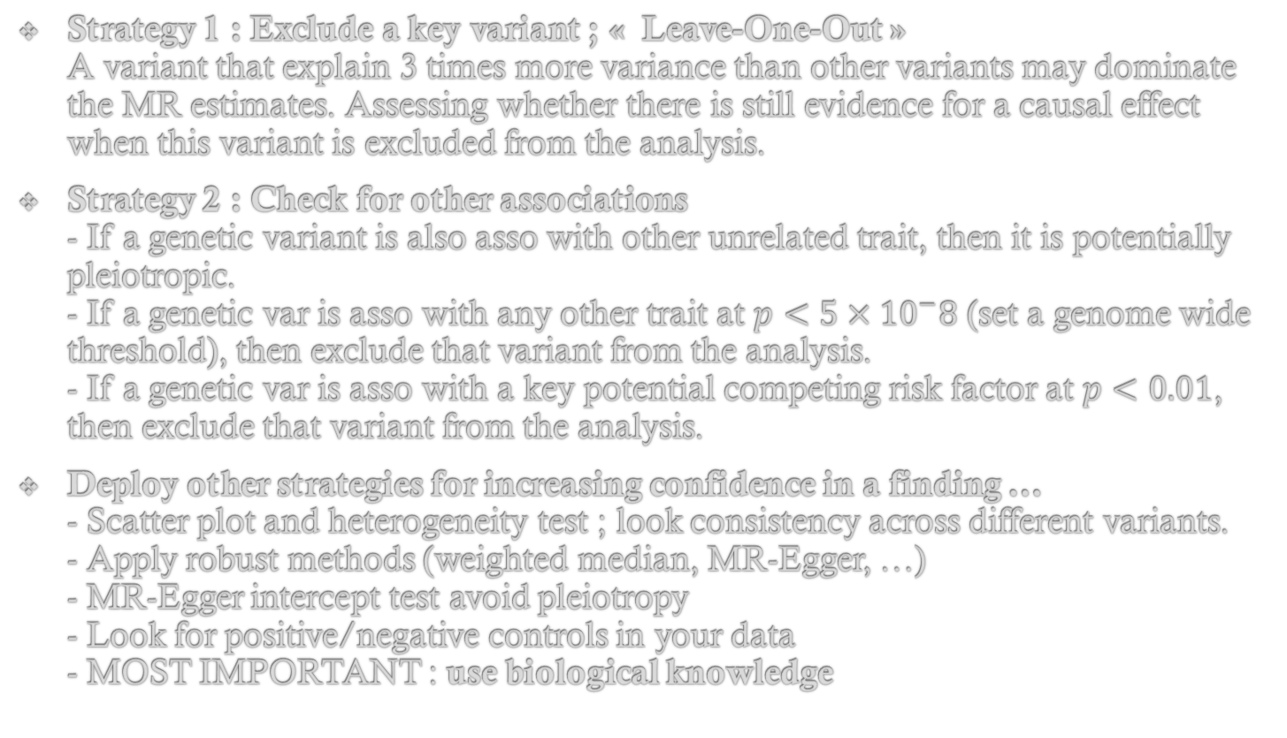
Sensitivity Analyses
Strategy 1 : Exclude a key variant ; « Leave-One-Out » A variant that explain 3 times more variance than other variants may dominate the MR estimates. Assessing whether there is still evidence for a causal effect when this variant is excluded from the analysis.
Strategy 2 : Check for other associations - If a genetic variant is also asso with other unrelated trait, then it is potentially pleiotropic. - If a genetic var is asso with any other trait at $p<5×{10}^{−}8$ (set a genome wide threshold), then exclude that variant from the analysis. - If a genetic var is asso with a key potential competing risk factor at $p<0.01$, then exclude that variant from the analysis.
Deploy other strategies for increasing confidence in a finding … - Scatter plot and heterogeneity test ; look consistency across different variants. - Apply robust methods (weighted median, MR-Egger, …) - MR-Egger intercept test avoid pleiotropy - Look for positive/negative controls in your data - MOST IMPORTANT : use biological knowledge
Notes:
Worthwhile to repeat the analysis excluding this key variant,
Stratégie 2 - Exclude too many var in a pathways may affect results, off course…

Slide 37

Usefull Links
MR-Base shiny web-app that allows the fitting of models (gmail connection). May help to have fast results, examples of Cohorts, Traits, and just few QC…
Choose risk factors, outcomes, many datasets…
LD clumping : to not double count the same information, filter correclated SNPs
LD proxies : if in the 2nd dataset I can’t found my SNP, use proxies (1=> super correlated)
palindromic SNPs : difficult to harmonize, may filter it
Allele harmonization : positive strand ?
Select methods, and go for it !
Sample size calculation with a continuous or binary outcome: https://shiny.cnsgenomics.com/mRnd/
Sample size calculation with a continuous or binary outcome: http://sb452.shinyapps.io/power/
Fieller’s theorem for confidence intervals with a single instrumental variable: http://sb452.shinyapps.io/fieller/
Likelihood-based method (with heterogeneity test) with summarized data: http://sb452.shinyapps.io/summarized/

Slide 38

R Packages Needed in Practical Session
ivpack
meta
MendelianRandomization
TwoSampleMR
https://github.com/mboissel/MR_training

Slide 39
I thank speakers from the Cambridge University Training Stephen Burgess Apostolos Gkatzionis Amy Mason Verena Zuber Dipender Gill Andrew Grant
I thank my collaborators from UMR1283 – EGID for MR projects on going
Philippe Froguel
Amélie Bonnefond
Amna Khamis Lucas Maurin Vincent Pascat
And all the lab for data generation

Slide 40

Thank You For Your Attention !

Slide 41
Guidelines

Slide 42
Checklist for Reviewing Mendelian Randomization Investigations
What is the primary hypothesis of interest? What is the motivation for using Mendelian randomization? What is the scope of the investigation? What and how many primary analyses?
Data sources What type of Mendelian randomization investigation is this? One-sample or two-sample? Sample overlap? Summarized data or individual-level data? Drawn from same population? Relevance to applied research?
Selection of genetic variants – how were the genetic variants chosen? Single or multiple gene regions?
Biological rationale?
GWAS analysis? If so, what dataset? What was the p-value threshold? Clumping?
Were genetic variants excluded from the analysis? Associations with pleiotropic pathways?
How else was the validity of genetic variants as instrumental variables assessed?
Variant harmonization (for two-sample analyses) Was it checked that genetic variants were appropriately orientated across the datasets?
Primary analysis What was the primary analysis? What was the statistical method? How implemented? Multiple testing? -Supplementary and sensitivity analyses What analyses were performed to support and assess the validity of the primary analysis? For example: stricter criteria for variant selection, assess heterogeneity, robust methods, subgroup analysis, positive/negative controls, ‘leave-one-out’ analyses, colocalization (single gene region)
Data presentation How are the data and results presented to allow readers to assess the analysis and assumptions? For example: scatter plot, forest/funnel/radial plot, R2/F statistics, comparison of methods, power
Interpretation How have results been interpreted, particularly any numerical estimates?

Slide 43
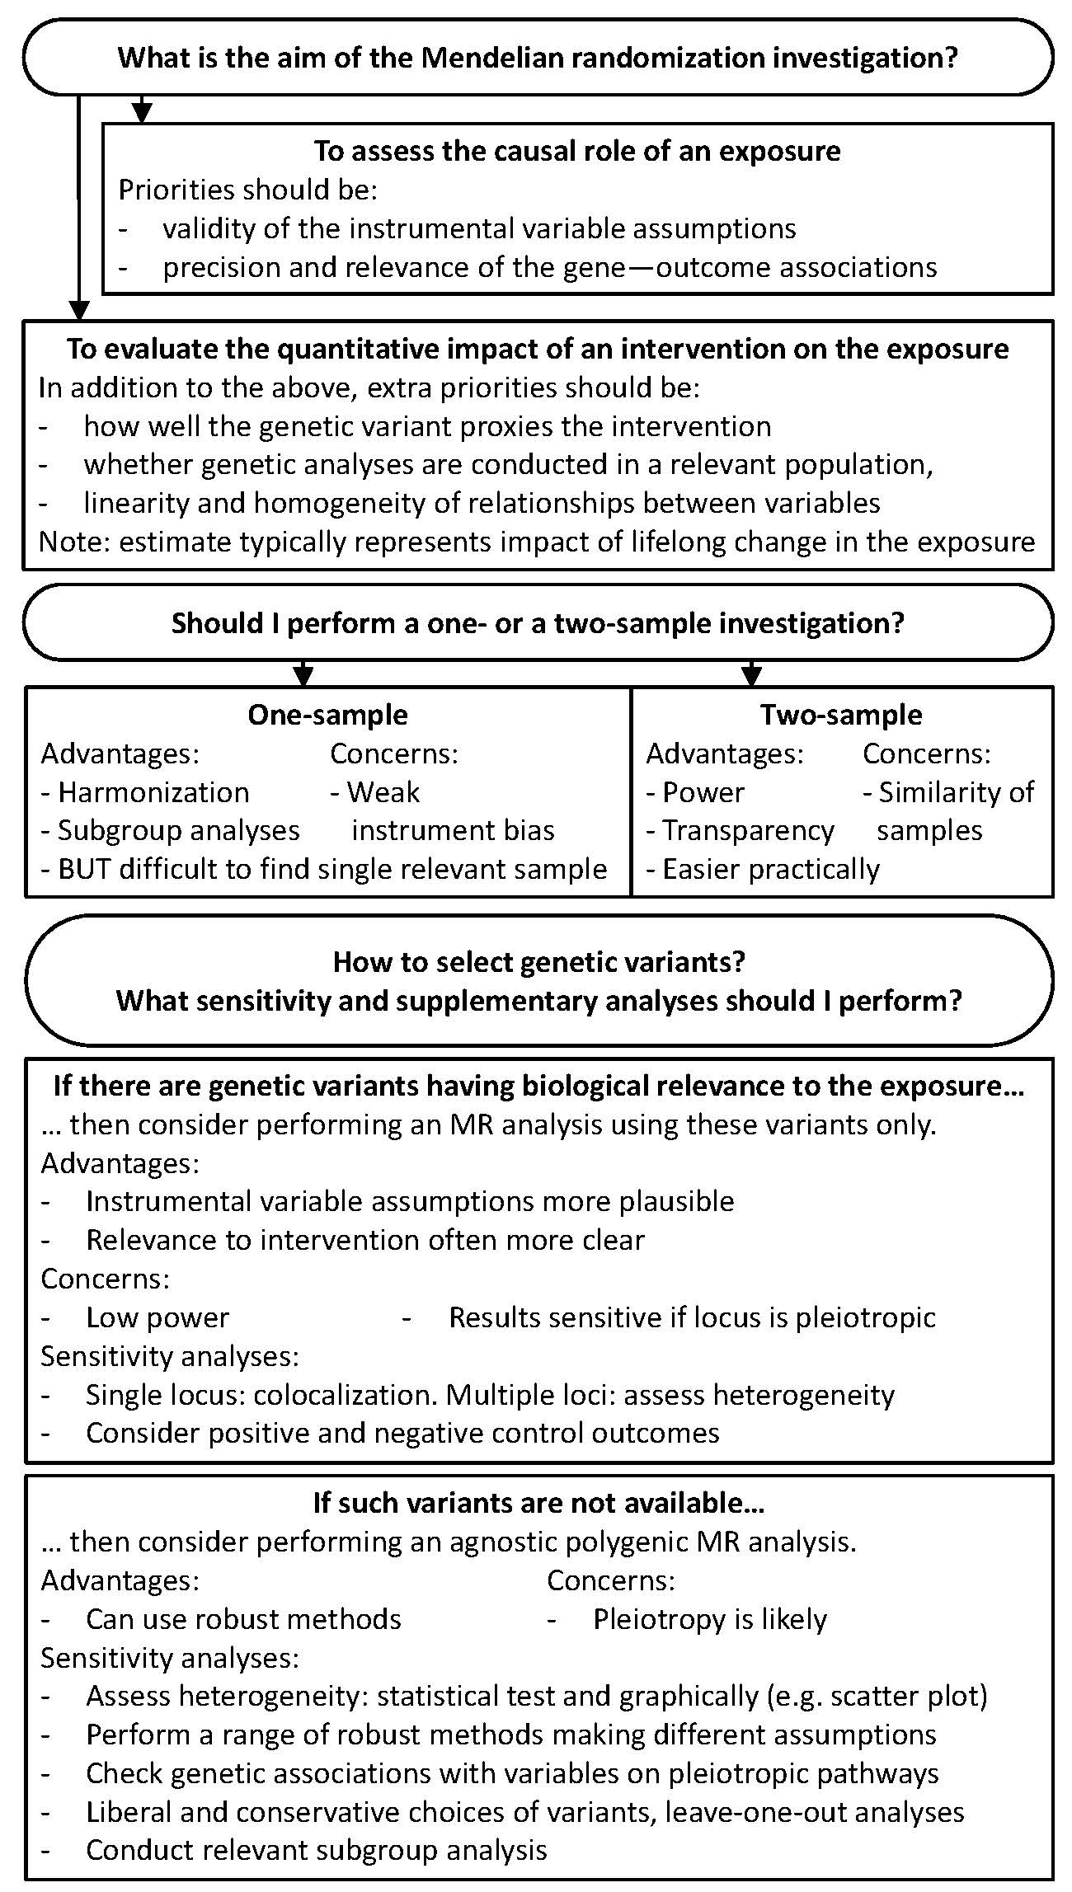
Flowchart while Reading a MR Paper …

Slide 44
Examples
Simple case X well-defined : The risk factor X is a single measurable protein biomarker. G chosen as a single gene region or strong biological connection to the risk factor (cis analysis, like in transcription factors) The underlying biology connecting G to X to Y well known : good understanding of a string biological connection (drug results or pathways).
Complex trait X is a complex polygenic trait G must be a multiple gene regions where you use biological information to pick genetic variants. Heterogeneity between genetic variants is expected and evidence for causation weaker. Sensitivity analyses are essential.
Complex and unknown traitX is a risk factor complex & no biological link. G is built with stat methods (GWAS) but the function of variants is unknown : Multiple gene regions, statistically chosen instrument (“trans” studies) The underlying biology won’t be obvious, need functionnal experiments ?

